Slide 1
Heart failure clinical records data mining with Bayesian methods
Yuhuan Cheng/ Shi Cen/ Chengyu Zhou/ Jianheng Chen
May 2nd 2022
ST 540 Final Project

Slide 2
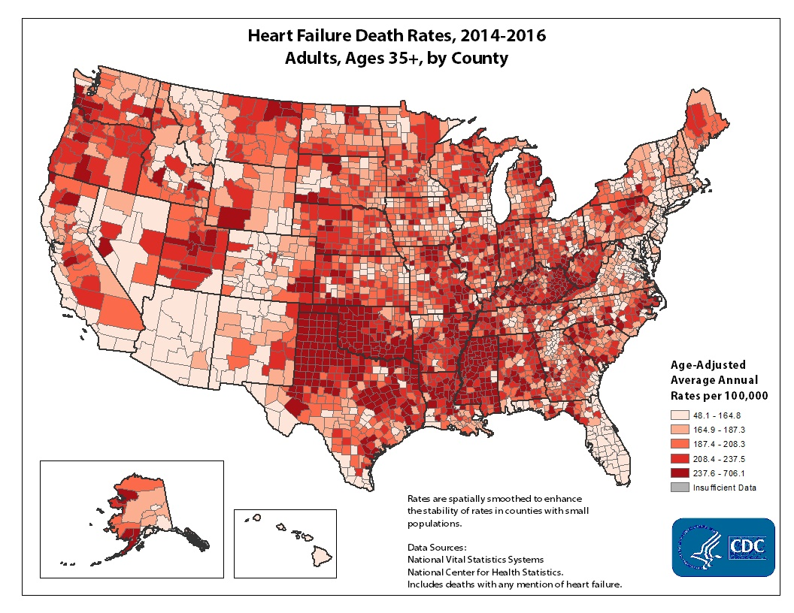
Introduction
About 6.2 million adults in the United States have heart failure ¹
In 2018, heart failure was mentioned on 379,800 death certificates (13.4%) ¹
Clinical records data mining enables the identification of risk factors that can predict survival of patients with heart failure
Ref 1. Virani SS, et al., Circulation. 2020.

Slide 3
Yuhuan Cheng
Dataset
13 clinical features of 299 patients from a survival analysis ²
We divided the whole dataset into a training set (160 instances) and a testing set (139)
We shuffled the dataset to include half-dead, half-survived instances in the training set
Response variable: death event (0,1) if the patient deceased during the follow-up period
Covariates:
7 continuous variables: age, creatinine phosphokinase (CPK), ejection fraction, platelets, serum creatinine, serum sodium and time
5 discrete variables: anemia, high blood pressure, diabetes, sex, smoking
Time is the follow-up period (days), which we didn’t include in our model simulation because it apparently lacks clinical significance for survival prediction
Ref 2. Davide Chicco, et al., BMC. 2020. https://doi.org/10.1186/s12911-020-1023-5

Slide 4
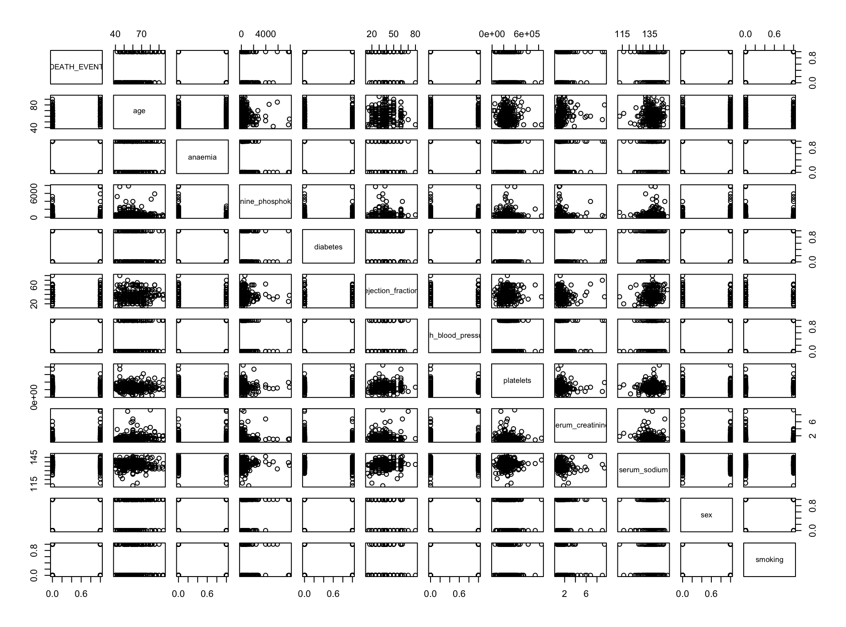
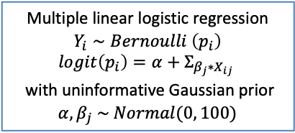
Yuhuan Cheng
Exploratory data analysis
No clear linear pattern between variables
Slight differences between dead/survived groups for some variables

Slide 5
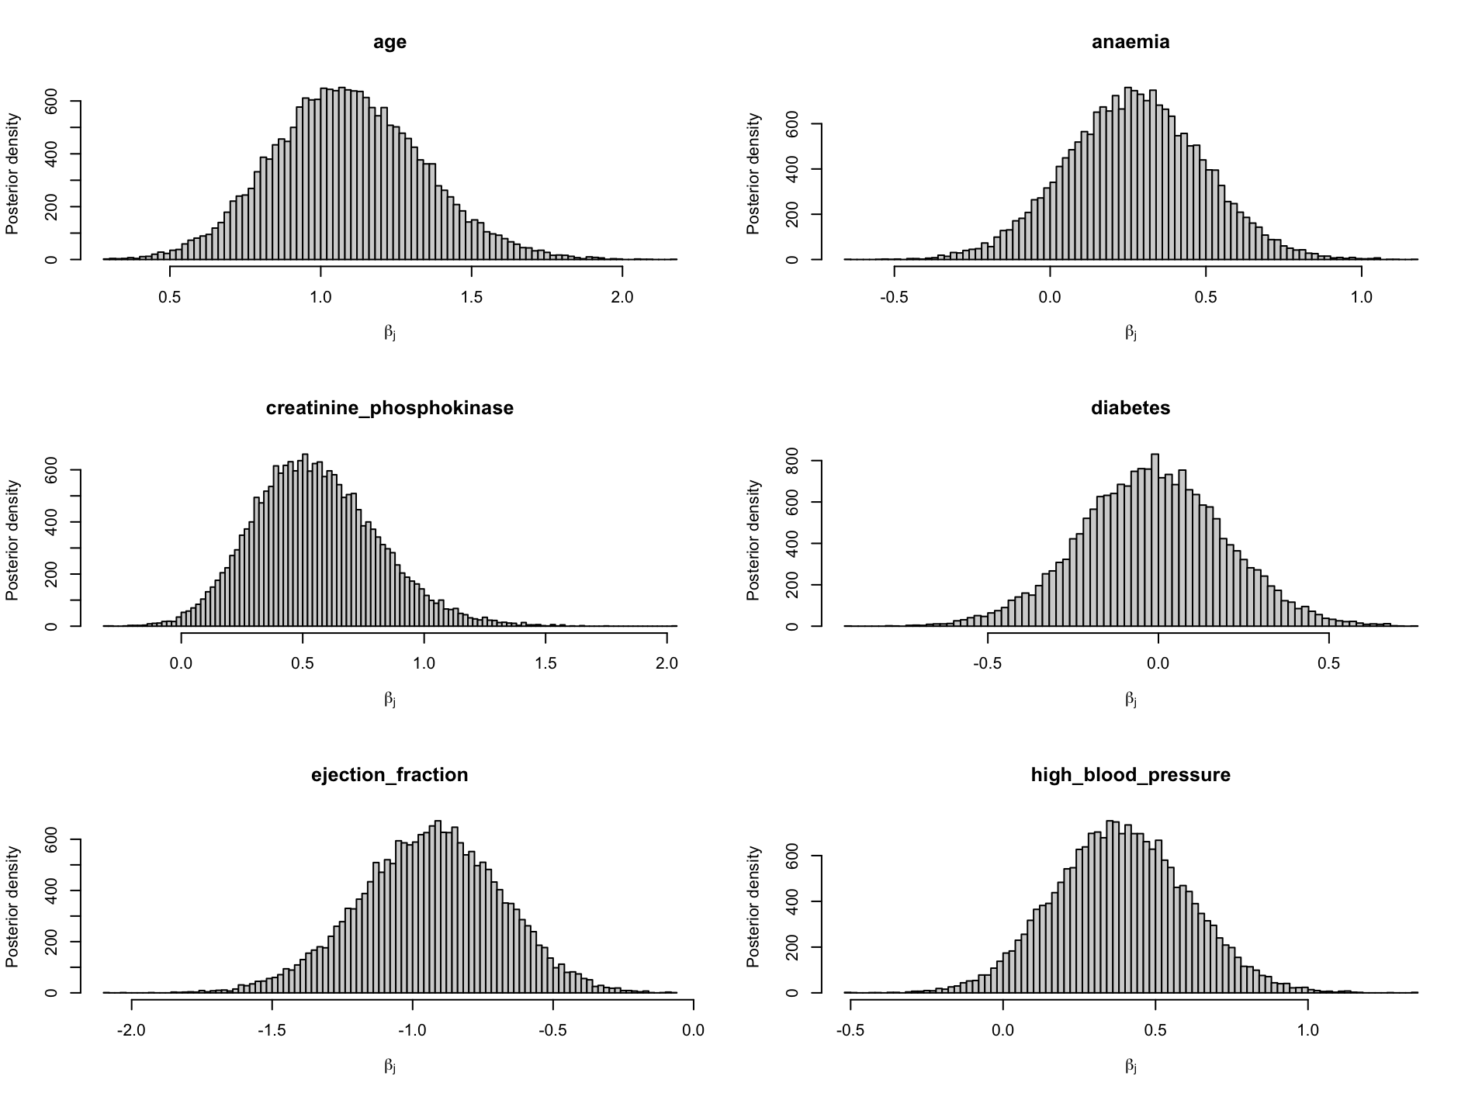
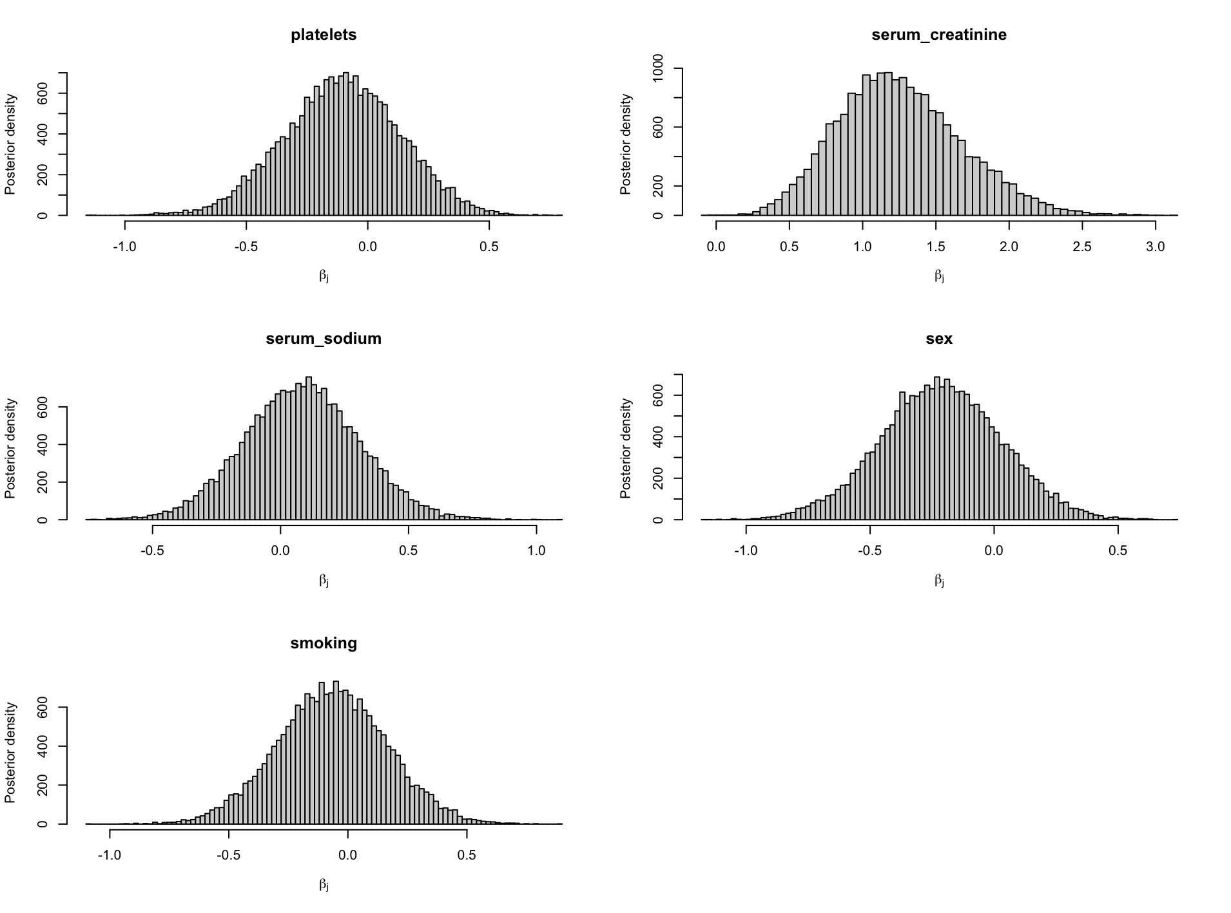
Yuhuan Cheng
Logistic regression with uninformative Gaussian prior
DIC:
Mean deviance: 172.2
penalty 11.95
Penalized deviance: 184.2
WAIC: 186.77

Slide 6
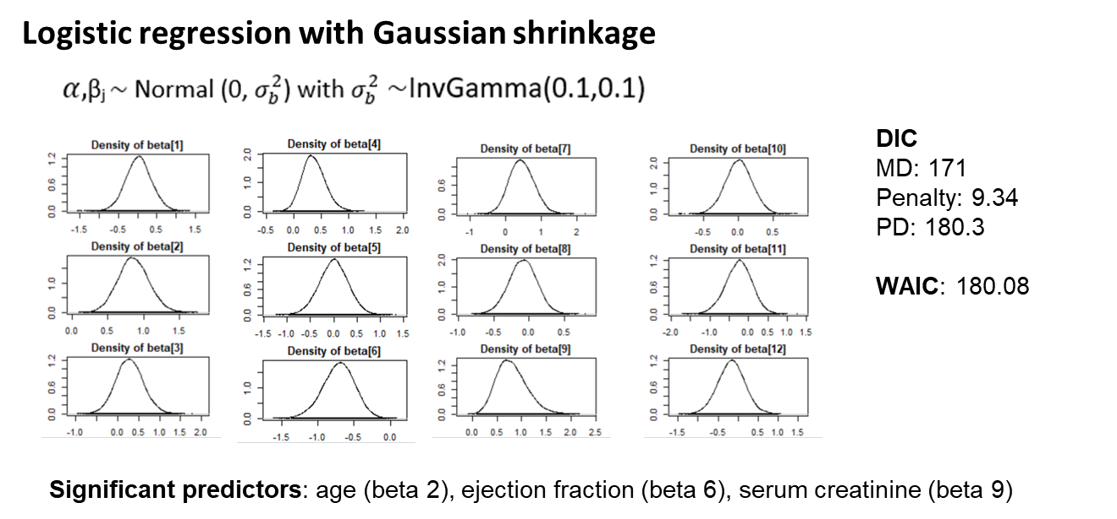
Chengyu Zhou

Slide 7
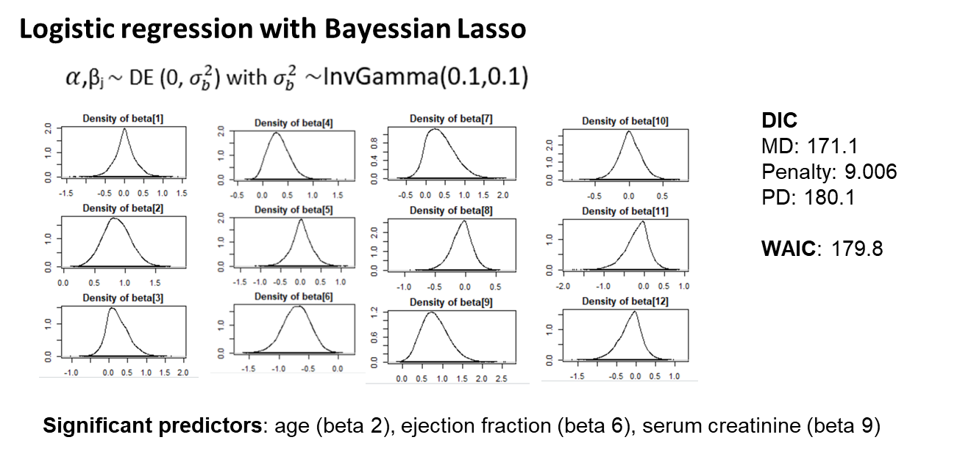
Chengyu Zhou

Slide 8
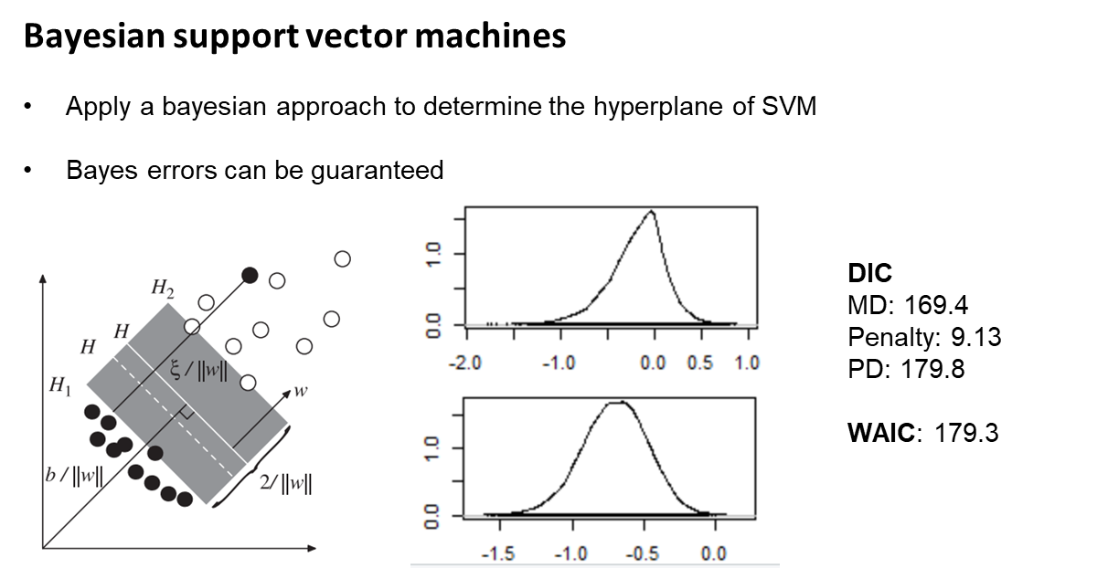
Chengyu Zhou

Slide 9
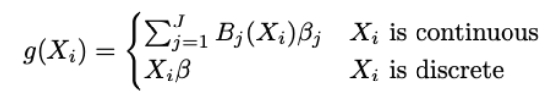
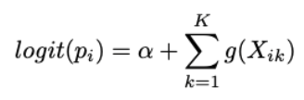
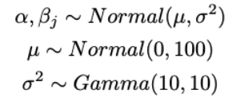

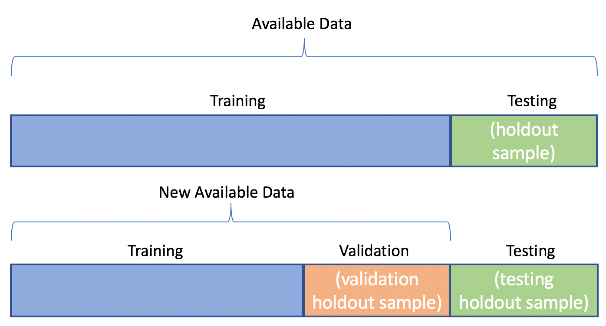
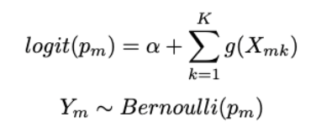
Semi-parametric model fitting
Shi Cen
Cubic spline basis function were used.
with
DIC
n=112
n=48
Candidate J value:
J=5, 10 or 20
Accuracy

Slide 10
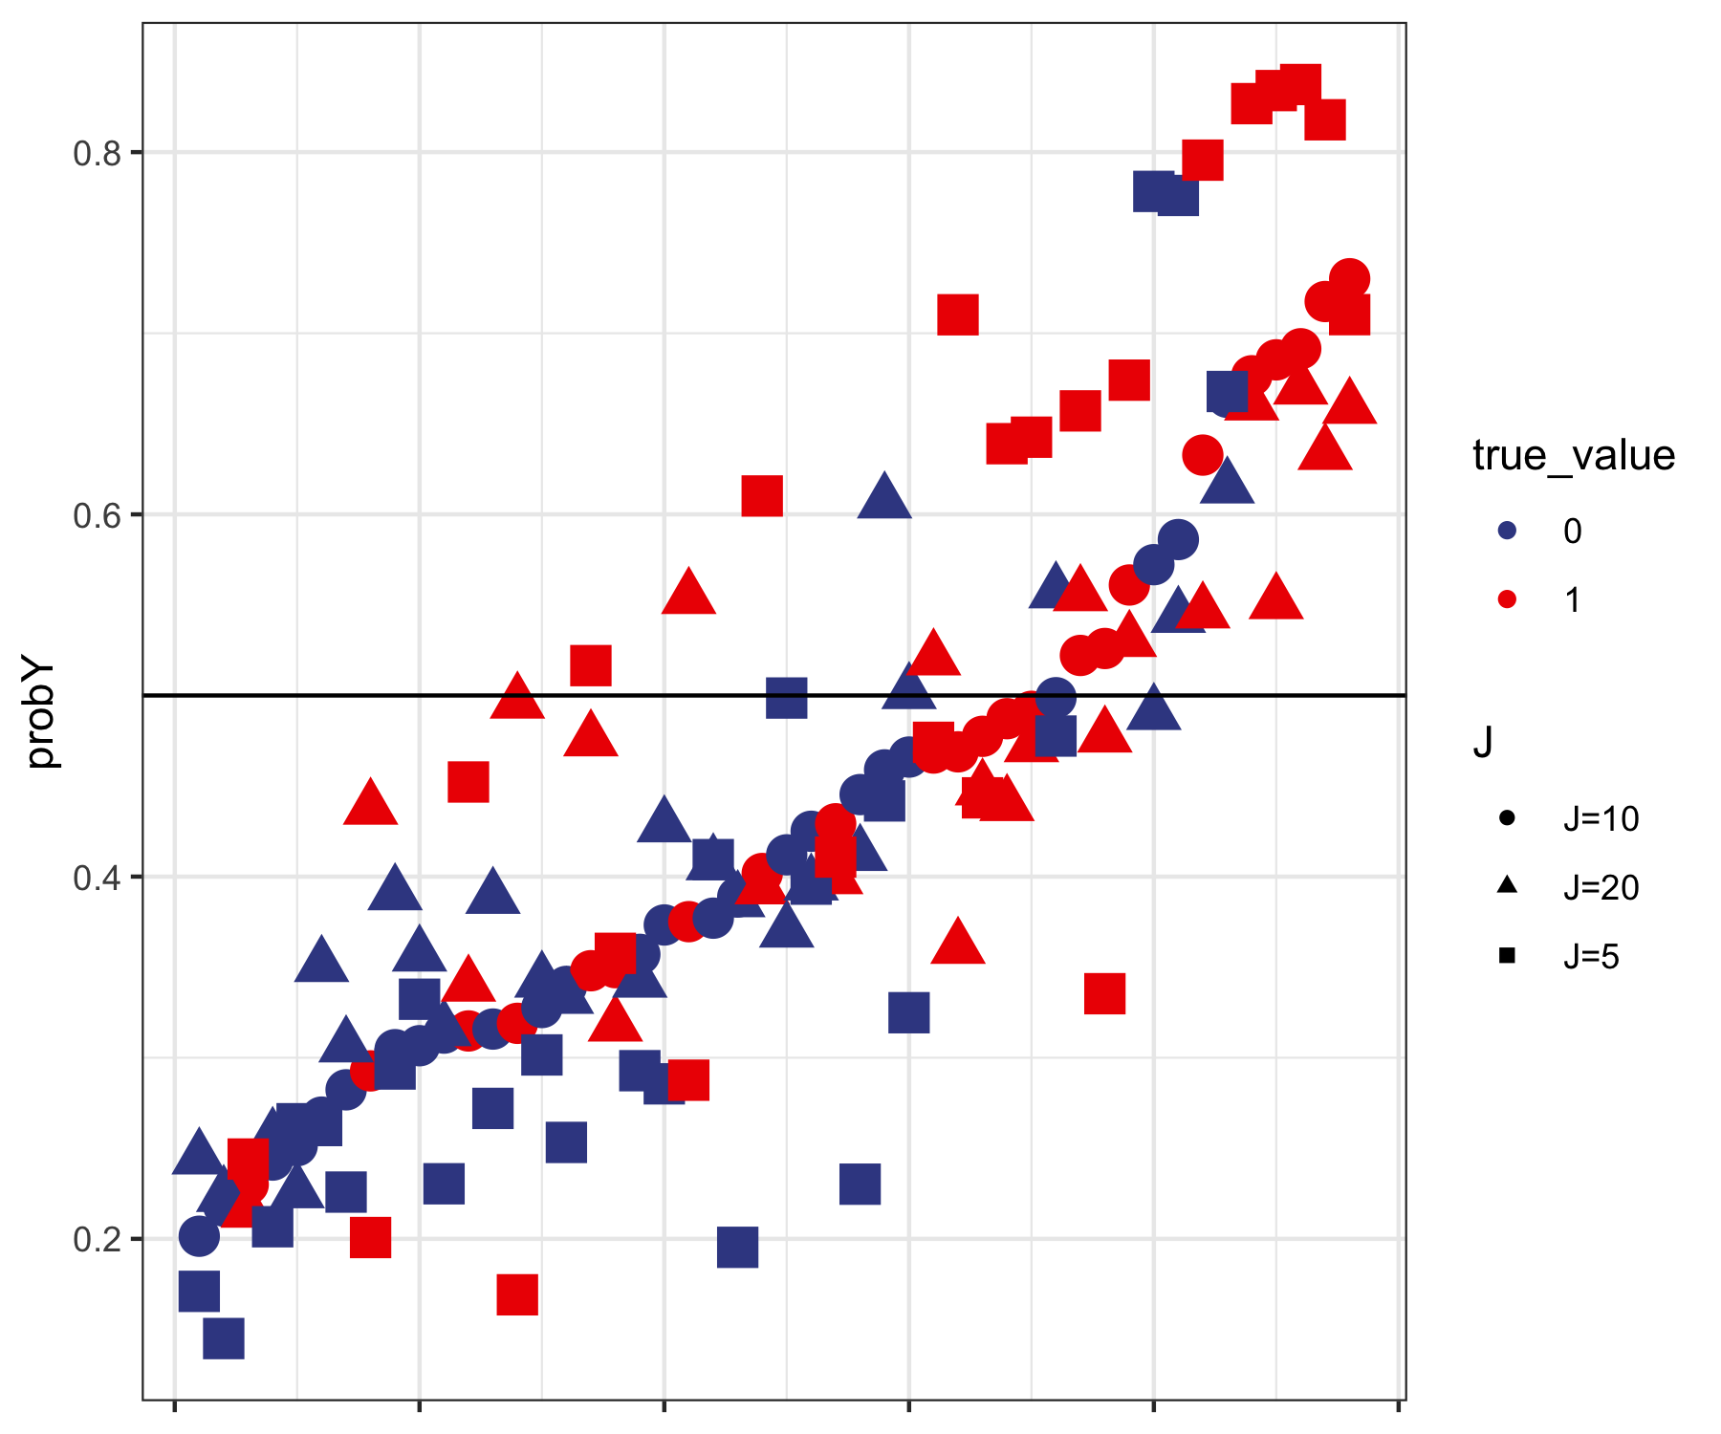
Semi-parametric model fitting
Shi Cen
 | J=5 | J=10 | J=20
DIC for training dataset (with penalty) | 137 | 146.1 | 147.8
Mean Accuracy on validation dataset | 60.26% | 55.77% | 54.92%
DIC for training + validation dataset | 186.9 | 201.5 | 202.7

Slide 11
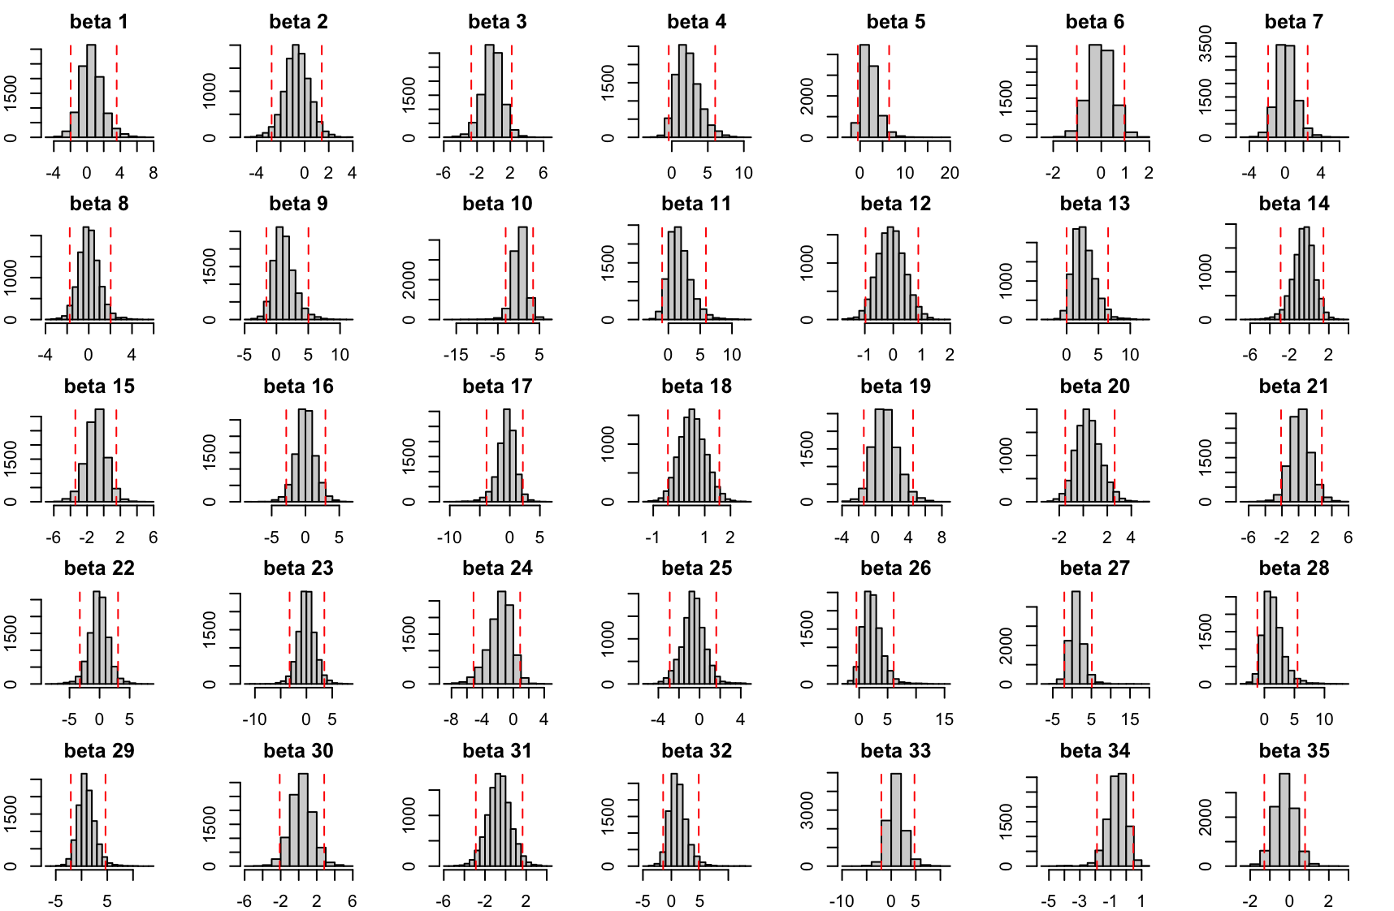
Semi-parametric model fitting
Shi Cen
All the 95% credible intervals of 𝛽 contained 0.
Advantage:
Low deviance for the model
Disadvantage:
Overfitting
Lose the meaning of coefficients.

Slide 12
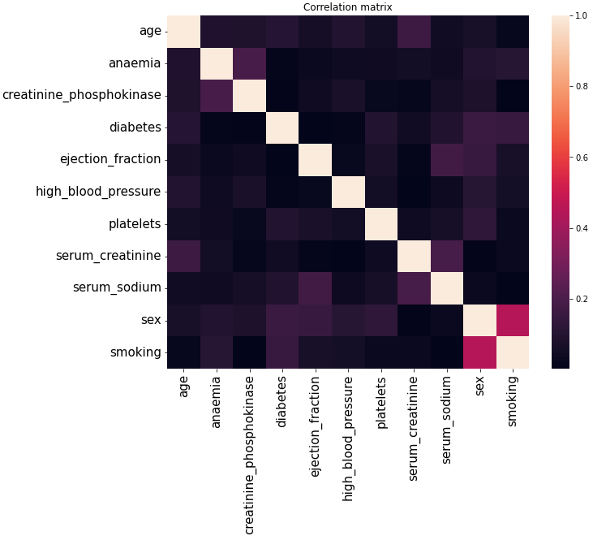





Naive Bayes Classifier
Jianheng Chen
Gaussian Naive Bayes:
Multinomial Naive Bayes:
Parameters estimated using maximum likelihood

Slide 13
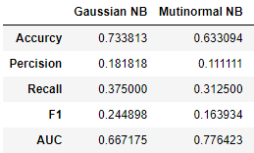
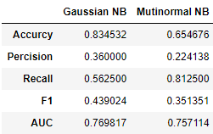
Naive Bayes Classifier
Jianheng Chen
Data set 1:
All features
(exclude sex)
Test Result:
Gaussian Naive Bayes:
Multinomial Naive Bayes:
Data set 2:
Significant features
Test Result:
Parameters estimated using maximum likelihood

Slide 14
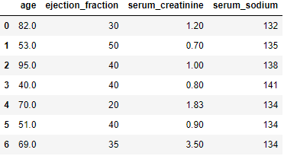
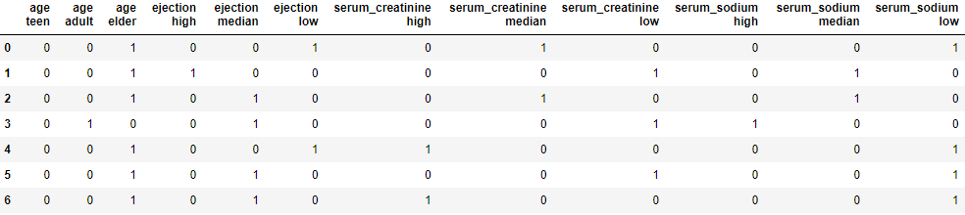
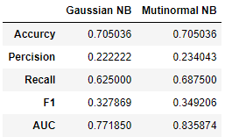
Naive Bayes Classifier
Jianheng Chen
Data set 2:
Significant features
Test Result:
Data set 3:
Significant features
(One-hot encoding)
Test Result:

Slide 15
Conclusion: Model compare
 | Gaussian NB | Multinomial NB | Logistic 1 | Logistic 2 | Logistic 3 | Semi-parametric J = 5 | Semi-parametric J = 10 | Semi-parametric J = 20 | Bayesian SVM
DIC | - | - | 184.2 | 180.3 | 180.1 | 186.9 | 201.5 | 202.7 | 179.8
Accuracy | 0.705 | 0.705 | 0.647 | 0.633 | 0.633 | 0.763 | 0.719 | 0.194 | 0.757
Precision | 0.222 | 0.234 | 0.211 | 0.203 | 0.193 | 0.282 | 0.244 | 0.125 | 0.241
Recall | 0.625 | 0.688 | 0.750 | 0.750 | 0.688 | 0.688 | 0.688 | 1.00 | 0.835
F1 | 0.328 | 0.349 | 0.329 | 0.320 | 0.301 | 0.400 | 0.361 | 0.222 | 0.323
AUC | 0.772 | 0.836 | 0.757 | 0.745 | 0.742 | 0.846 | 0.835 | 0.790 | 0.827

Slide 16
Areas for future research
Explore more diverse databases/features
Apply bootstrapping sampling method
Apply One-hot encoding for all model
Incorporate the Interaction between features into the model

Slide 17
References
Virani SS, Alonso A, Benjamin EJ, Bittencourt MS, Callaway CW, Carson AP, et al. Heart disease and stroke statistics—2020 update: a report from the American Heart Association external icon. Circulation. 2020;141(9):e139-596.
Davide Chicco, Giuseppe Jurman: "Machine learning can predict survival of patients with heart failure from serum creatinine and ejection fraction alone". BMC Medical Informatics and Decision Making 20,16 (2020).
Jiangsheng Yu a,, Fei Cheng b , Huilin Xiong c , Wanling Qu a , Xue-wen Chen d::A Bayesian approach to support vector machines for the binary classification. Neurocomputing (2008)
Florian Wenzel, Theo Galy-Fajou, Matthaeus Deutsch, Marius Kloft. Bayesian Nonlinear Support Vector Machines for Big Data. ECML-PKDD (2017)

